Slide 1


Capstone Project Phase 2 Flying Packages Project number: 23-1-D-29 Advisor: Prof. Zeev Barzily Mousa Srour 205798812 Wessam Ghrayeb 211756820 Date: 26/6/2023
1

Slide 2

Outline
Introduction
Problems and solutions
UML diagrams
Technologies used
Video
Tests
THeCHNICAL CHALLENGES

Slide 3
01
Introduction
3

Slide 4

As everyone is aware, the topic of deliveries and delivery firms has gained traction in recent years.
Today, nearly no business that sells an item of value to clients does not provide a delivery service, whether it is restaurants, shops, grocery stores, etc..., even if a big portion of those firms transfer their delivery services to an external organization.
We intended to create a solution that blends concepts from several applications and websites into a single efficient and user-friendly offering.

Slide 5

02
Problems And Challenges
5

Slide 6

The Problems and the Challenges that we wanted to solve
01
02
03
The first goal is to reduce delivery time: as soon as a new order is received from any business, you must arrange for a courier who is close to the delivery pickup point in terms of location.
The second purpose was to include the customer in the courier selection process: for example, if a restaurant had a terrible experience with a certain courier, that restaurant may not want the courier to do the next deliveries for it.
If we achieve both objectives, we will ensure that the company's efficiency is improved while also maintaining the satisfaction of customers.
6

Slide 7

03
We resolved the issues by implementing the following solutions
7

Slide 8
How did we ensure that a courier was assigned nearby the particular delivery?
We saved each courier's location at any given time; when a courier's connects to the system, he can change his location.
We also made certain that each business preserved its current place of business and so know the collecting site for that business's deliveries.
We compute the route length of all available couriers from the collecting point as soon as an order was received from one of the businesses, resulting in the courier with the shortest distance.
8

Slide 9
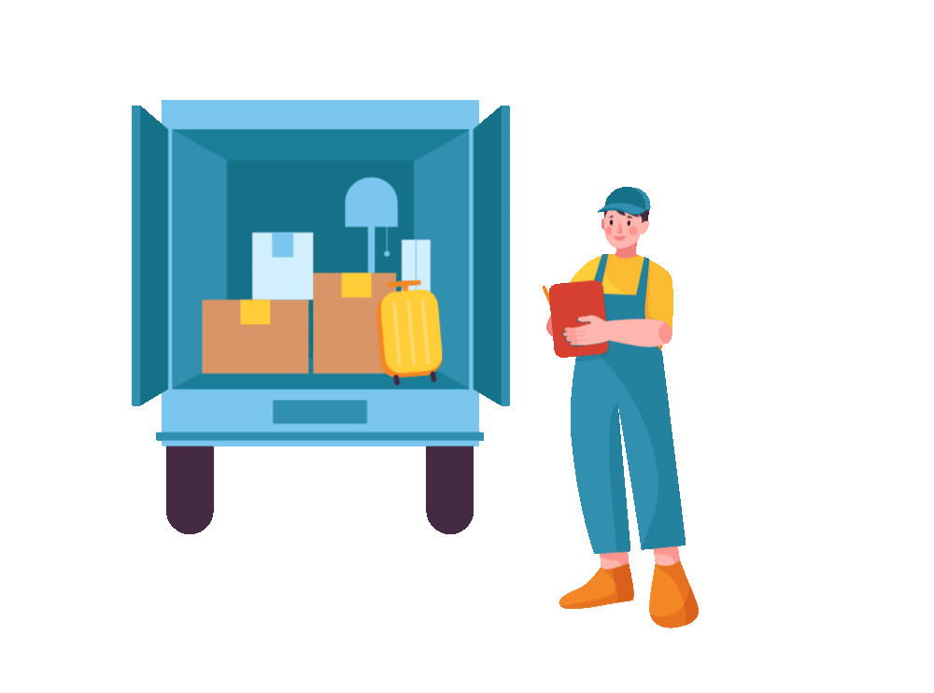
How did we combine the experience of the supplier with choosing the courier?
As soon as we have the length of all the routes of couriers available from the shipment collection point, we will offer the customer the 4 couriers closest to him and thus he can choose one of them to carry the shipment for him.
9

Slide 10

How to ensure that the choice of the business does not harm the efficiency of the system
It is true that we offer the four closest couriers, but if certain couriers are at a distance that exceeds the threshold we defined, they will not be presented to the customer, and he will choose from three or two couriers for example.

Slide 11
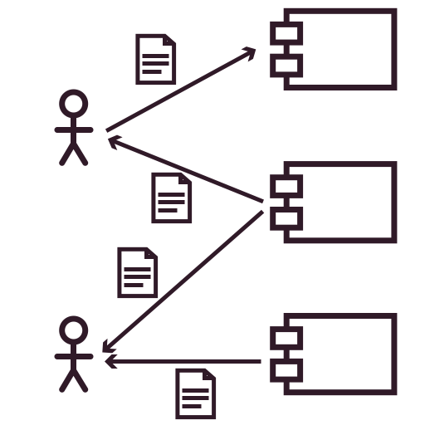
04
UML Diagrams
11

Slide 12
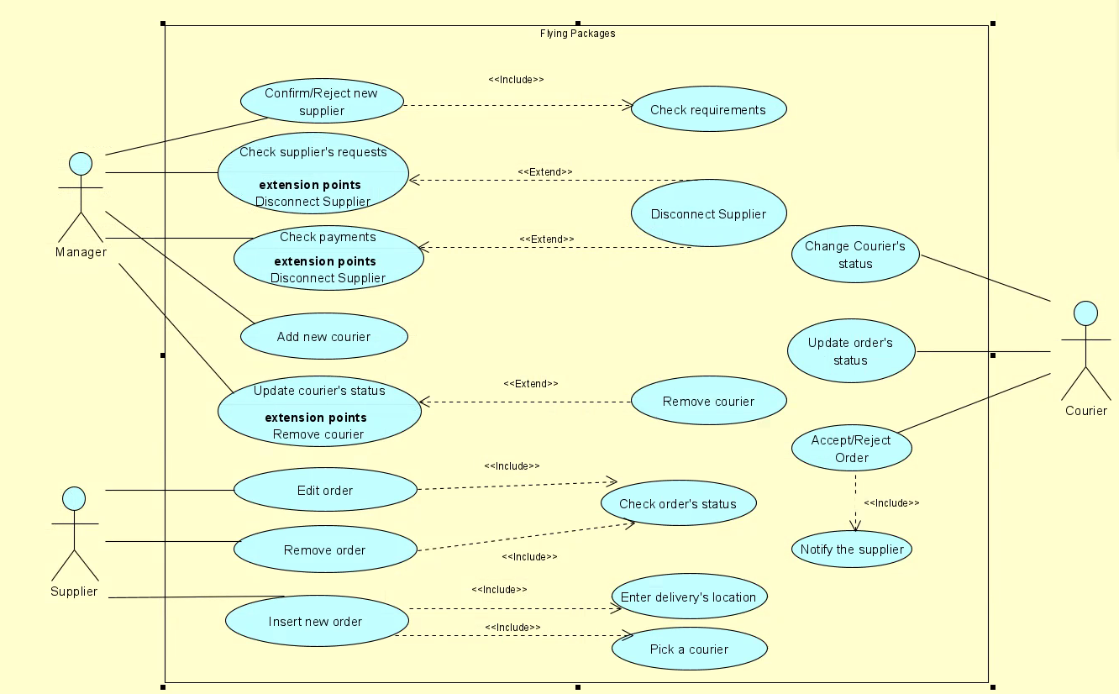
Use Case
12

Slide 13
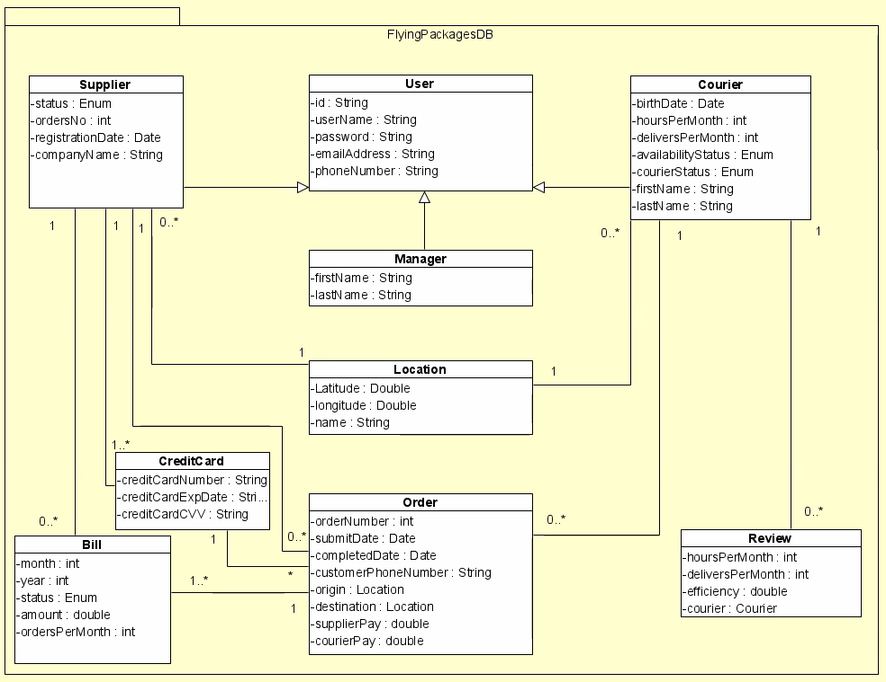
Class Diagram
13

Slide 14
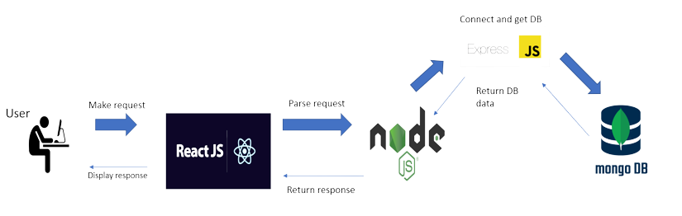

Technologies used
MERN-STACK
14

Slide 15

Now we will present our website!
15

Slide 16

Tests & Verification
16

Slide 17
Unit tests
No# | Test Subject | Expected Result | Result
Login form
1 | Enter an empty username or password | Error displays a message: “Please fill in the fields”. | Passed
2 | Enter the wrong username or password | Error displays a message: “Invalid details, try again” We don’t want to give information about which field is invalid. | Passed
3 | Log in with a ‘frozen’ status username and password | Display message: “User is Frozen”. | Passed
4 | Enter a valid username and password | Display message:” Login succeed”. | Passed
Supplier’s registration form
5 | Enter an existing name and location | Error displays a message: “This supplier is already existing” | Passed
6 | Enter empty details (one or more) | Display message: “Please fill in the fields”. | Passed
7 | Enter valid details | Display a message: “Registration succeed, please wait for approvement”. | Passed
17

Slide 18
Functional tests
No# | Test Subject | Expected Result | Result
Login form
1 | Login with a valid supplier username and password | Move to the supplier’s form. | Passed
2 | Login with a valid courier username and password | Move to the courier’s form. | Passed
3 | Login with a valid manager username and password | Move to the manager’s form. | Passed
Add new order
8 | Submit a new order from the supplier’s form. | The order will appear in the order list in the manager’s form. | Passed
9 | The optimal courier for the mission has been found. | The courier gets an SMS that includes the delivery details. | Passed
10 | The courier confirms that he will handle the order | The order’s status will change from ‘pending’ to ‘in progress’. | Passed
11 | The courier updates that he finished his mission | The order’s status will change from ‘in progress’ to ‘completed’ | Passed
18

Slide 19

Technical Challenges
Learning new languages and technologies: We could have gone for technologies and languages we knew before, but we wanted to challenge ourselves and learn new things. It was not particularly easy in the implementation phase we had a lot of self-learning.
Calculating the shortest route: we used the google maps platform at the end to update the location and compute the distances with the provided coordinates from google.
Integrate Google’s Place details, search, and autocomplete into our website.
This platform is basically a Geo Location feature that gives the place details, it converts coordinates into addresses and addresses into coordinates.
Also, let us get an estimated device location.

Slide 20

Thank you for your attention!
20

